Slide 1
Year 10 Subject Selection for Stage 6 - 2020
For Year 10 students and their parents.

Slide 2
Year 10 Subject Selection for Stage 6
Purpose of this presentation
This presentation has been developed to assist schools to provide relevant NSW Education Standards Authority (NESA) information to
Year 10 students and their parents.

Slide 3
Year 10 Subject Selection for Stage 6
Course Selection Considerations
Abilities
Interests/Motivation
Career aspirations and needs
Syllabus requirements - Practical/Major work components
Subject combinations
Other commitments
Notes:
Abilities - choose subjects where you are capable of doing well.
Interests/Motivation- choose subjects that interest you.
Career aspirations and needs - keep in mind future career paths but be realistic about choices.
Syllabus Requirements – be mindful of how many practical works and major works are required for your pattern of study and the timing of submission.
Subject combinations - do the subjects complement each other?
Other commitments - when choosing subjects, it its important to balance study with outside commitments and influences such as work, sport and family.
https://educationstandards.nsw.edu.au/wps/portal/nesa/11-12/hsc/subject-selection

Slide 4
Year 10 Subject Selection for Stage 6
The Higher School Certificate
is the culmination of a student’s school career
is the highest educational award that can be achieved at secondary school in NSW
reports student achievement in terms of a standard achieved in individual courses
presents a profile of student achievement across a broad range of subjects
Notes:
http://educationstandards.nsw.edu.au/wps/portal/nesa/11-12/hsc/subject-selection

Slide 5
Year 10 Subject Selection for Stage 6
HSC Course Structure
All courses in the HSC have a unit value
Most courses are 2 units which equates to 120 hours of study and a HSC result out of 100
Some courses are 1 unit. This is equivalent to 60 hours of study and a HSC result out of 50
Many 1 unit courses are extension courses, enabling 3 or 4 units of a course to be studied
Notes:
http://educationstandards.nsw.edu.au/wps/portal/nesa/11-12/hsc/subject-selection
https://ace.nesa.nsw.edu.au/ace-8064

Slide 6
Year 10 Subject Selection for Stage 6
Requirements for the HSC
Year 11
minimum of 12 units
students must satisfactorily complete the Year 11 course before commencing the corresponding Year 12 course
Year 12
minimum of 10 units
Notes:
Students may accumulate course units towards the HSC for a period of up to 5 years.
Students may choose to undertake this ‘pathway’ approach for a variety of reasons including:
commitments outside school - part time work, elite sportsperson etc.
apprenticeship or traineeship
acceleration
repeating
http://educationstandards.nsw.edu.au/wps/portal/nesa/11-12/hsc/subject-selection
https://ace.nesa.nsw.edu.au/ace-8036

Slide 7
Year 10 Subject Selection for Stage 6
Requirements for the HSC
Both the Year 11 and Year 12 pattern of study must include:
2 units of compulsory English
at least 6 units of Board Developed Courses
at least 3 courses of 2 units value or greater
at least 4 subjects (including English)
a maximum of 6 units of Science may be included in the Year 11 pattern of study.
a maximum of 7 units of Science may be included in the Year 12 pattern of study.
Notes:
English is mandatory for the HSC.
English Studies and Mathematics Standard 1 are Board Developed Courses with an optional HSC examination. Students who choose English Studies and/or Mathematics Standard 1, but wish to receive an ATAR, must undertake the optional examination.
Extension course are not separate subjects. E.g. Advanced English (2 units) + Extension 1 (1 unit) + Extension 2 (1 unit) = 4 units but only 1 subject.
At most, 6 units of courses in Science can be included in the pattern of study for Year 11. However, from 2019 Year 12, this increases to 7 units of Science, to allow for the study of Science Extension.
https://ace.nesa.nsw.edu.au/ace-8005

Slide 8
Year 10 Subject Selection for Stage 6
Requirements for the HSC – meeting the minimum standard in literacy and numeracy
From 2020, students need to demonstrate they have met a minimum standard in literacy and numeracy to be eligible for a HSC.
Students will show they meet the HSC minimum standard by passing online tests of basic literacy and numeracy skills, which are available for them to sit when they are ready in Year 10, 11 and 12 and after the HSC.
Notes:
https://ace.nesa.nsw.edu.au/ace-4060
https://educationstandards.nsw.edu.au/wps/portal/nesa/11-12/hsc/hsc-minimum-standard

Slide 9
Year 10 Subject Selection for Stage 6
About the minimum standard online tests
Students get up to four times per year to sit each minimum standard reading, writing or numeracy test.
The test is available on all school days
About the tests:
Reading: 45 multiple choice computer adaptive questions (45 minutes)
Numeracy: 45 multiple choice computer adaptive questions (45 minutes)
Writing: answer one question out of a choice of two prompts.
Refer to the NESA website for more information and resources for parents, students and schools
Notes:
https://educationstandards.nsw.edu.au/wps/portal/nesa/11-12/hsc/hsc-minimum-standard/online-tests

Slide 10
Year 10 Subject Selection for Stage 6
Types of HSC Courses
Board Developed Courses | Board Endorsed Courses
HSC examination except for: optional examination in English Studies and Mathematics Standard 1 and VET Curriculum Framework courses all Life Skills courses | No HSC examination – school-based assessment only
May be included in the calculation of a student’s Australian Tertiary Admission Rank (ATAR). | Not included in the calculation of a student’s Australian Tertiary Admission Rank (ATAR).
Includes some Vocational Education and Training (VET) courses. | Includes some Vocational Education and Training (VET) courses.
Includes Life Skills courses.
Notes:
Board Developed Courses are developed by NESA and all students in the state study the same course content and complete the same HSC examination. These courses may contribute to the calculation of a student’s ATAR . Life Skills Courses do not have an examination and are not included in the calculation of an ATAR.
Board Endorsed Courses have syllabuses endorsed by NESA to cater for a wide candidature in areas of specific need not served by Board Developed Courses. These courses may offer an alternative career path for students.
https://ace.nesa.nsw.edu.au/ace-6001
https://ace.nesa.nsw.edu.au/ace-6005

Slide 11
Year 10 Subject Selection for Stage 6
Board Developed Courses and the ATAR
Category A Courses | Category B Courses
May be included in the calculation of a student’s Australian Tertiary Admission Rank (ATAR) | No more than 2 units of Category B courses can be included in the calculation of a student’s ATAR
Compulsory HSC Examination for most courses | Optional HSC examination for some courses
 | Include VET Curriculum Framework courses and have compulsory work placement.
Notes:
It is the responsibility of the Universities Admission Centre (UAC) to determine if a course can be included in the calculation of the ATAR.
Category A Courses have academic rigour and depth of knowledge to provide background for tertiary studies. Examples include Biology and Geography.
Category B Courses - no more than two units of Category B courses can be included in the ATAR calculation. Examples include Human Services and Hospitality.
Course category listings available at the UAC Website: https://www.uac.edu.au/future-applicants/atar/atar-courses. Go to HSC Board Developed courses to be examined in 2020 pdf.

Slide 12
Year 10 Subject Selection for Stage 6
SATISFACTORY COMPLETION OF A COURSE
Students must:
follow the course developed or endorsed by NESA
apply themselves with diligence and sustained effort to the set tasks and experiences provided in the course by the school, and
achieve some or all of the course outcomes
where applicable, complete mandatory work placement.
Notes:
https://ace.nesa.nsw.edu.au/ace-8019
https://educationstandards.nsw.edu.au/wps/portal/nesa/11-12/hsc/rules-and-processes

Slide 13
Year 10 Subject Selection for Stage 6
ADDITIONAL COMPLETION REQUIREMENTS FOR HSC COURSES
Students must:
complete HSC assessment tasks that contribute in excess of 50 per cent of available marks in courses where internal assessment marks are submitted, and
sit for and make a serious attempt at any requisite Higher School Certificate examinations for a course
Notes:
https://ace.nesa.nsw.edu.au/ace-8020
https://ace.nesa.nsw.edu.au/ace-8026

Slide 14
Year 10 Subject Selection for Stage 6
Confirmation of Entry
Students will receive a NESA Confirmation of Entry from the school
Before signing the Confirmation of Entry each year (Years 10, 11 and 12) students should check that they are:
enrolled in the correct courses
eligible for:
Year 10: Record of School Achievement
Year 11: Stage 6 Preliminary
Year 12: HSC
Notes:
https://ace.nesa.nsw.edu.au/ace-4003

Slide 15
Year 10 Subject Selection for Stage 6
HSC: All My Own Work
HSC: All My Own Work is a mandatory program designed to help HSC students to follow the principles and practices of good scholarship.
It consists of five modules:
Scholarship Principles and Practices
Acknowledging Sources
Plagiarism
Copyright
Working with Others
Notes:
Students must complete HSC: All My Own Work or its equivalent before they can be enrolled for any Preliminary or HSC course with NESA via Schools Online.
Only students entered for Stage 6 Life Skills courses are exempt from this requirement.
The HSC: All My Own Work program is integrated with other NSW syllabuses and programs. The program is designed to be delivered flexibly as self-paced learning modules.
The program is available on the NESA website: https://educationstandards.nsw.edu.au/wps/portal/nesa/11-12/hsc/hsc-all-my-own-work

Slide 16
HSC Credentials

Slide 17
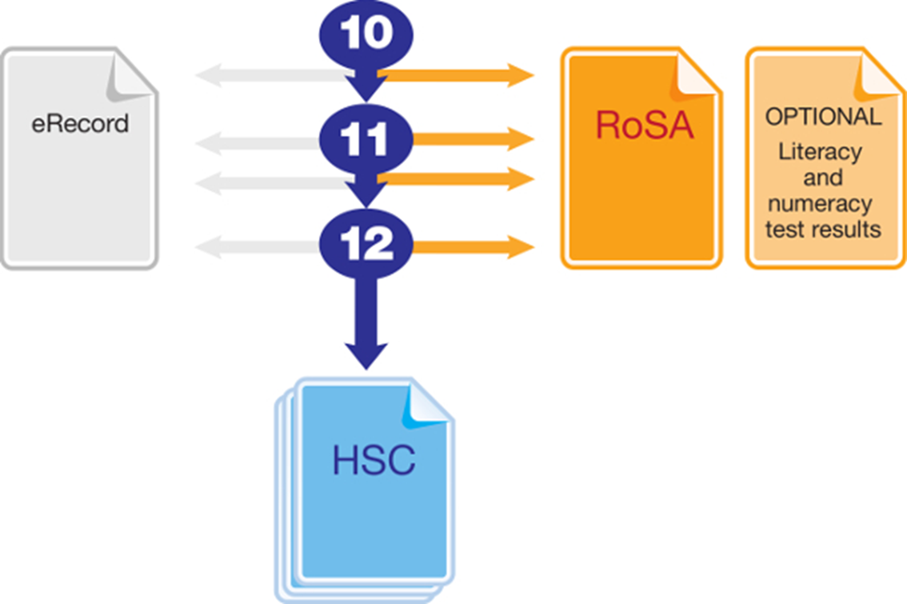
Year 10 Subject Selection for Stage 6
Record of School Achievement
Notes:
Eligible students who leave school before receiving their Higher School Certificate (HSC) will receive the NSW Record of School Achievement (RoSA).
The RoSA is a cumulative credential in that it allows students to accumulate their academic results until they leave school.
The RoSA records completed Stage 5 and Preliminary Stage 6 courses and grades, participation in any uncompleted Preliminary Stage 6 courses and HSC results for students who have not completed their HSC
It is of specific use to students leaving school prior to the HSC.
https://educationstandards.nsw.edu.au/wps/portal/nesa/11-12/leaving-school/record-of-school-achievement

Slide 18
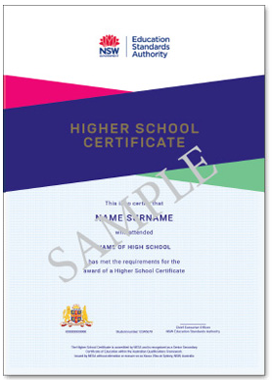
Year 10 Subject Selection for Stage 6
NSW HSC Testamur
Notes:
The HSC testamur shows that a student is eligible for the Higher School Certificate. It includes the student's name, school and date of the award.
https://educationstandards.nsw.edu.au/wps/portal/nesa/11-12/hsc/results-certificates/results-documentation

Slide 19
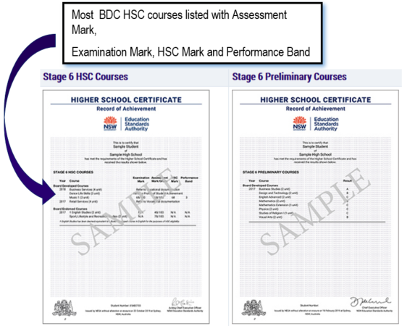
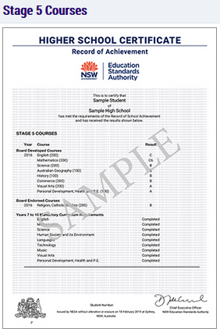
Year 10 Subject Selection for Stage 6
HSC Record of Achievement
All Preliminary and Stage 5 courses will be on separate certificates
Notes:
The Higher School Certificate (HSC) Record of Achievement (RoA) includes students' Year 12 HSC (Stage 6) results, Year 11 (Preliminary Stage 6) grades and, if applicable, Year 10 (Stage 5) grades. Results for each Stage appear on separate pages. This provides formal recognition of students' senior secondary school achievements.
Assessment mark: School-based assessment tasks measure performance in a wider range of course outcomes than can be tested in an external examination. Students are required to complete a number of assessment tasks for most courses, which may include tests, written or oral assignments, practical activities, fieldwork and projects. Schools submit an HSC assessment mark based on performance in these tasks for every student who completed an HSC course that has a compulsory external examination. NESA puts these assessment marks through a process of moderation to allow a fair comparison of marks in each course across different schools.
Examination mark: The examination mark for each course shows the student's performance in NESA's HSC examination for that course. The examination in most courses consists of a written paper and, for some courses, may include speaking and listening examinations, practical examinations, or major works that are submitted for external marking. Each student's achievement is assessed and reported against set standards of performance.
HSC mark: The HSC mark in courses with a compulsory external examination is a 50:50 combination of a student's external examination mark and their school-based assessment mark for the course. In courses with optional examinations, the HSC mark is drawn from the external examination only.
https://educationstandards.nsw.edu.au/wps/portal/nesa/11-12/hsc/results-certificates/results-documentation

Slide 20
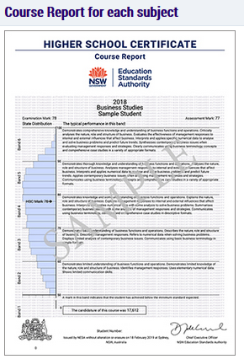
Year 10 Subject Selection for Stage 6
HSC Course Report
Notes:
Performance band: A student's HSC mark is reported against standards described in the performance bands. For each 2-unit course there are six performance bands, where the highest achievement is Band 6 (90–100 marks) and where the minimum standard expected is Band 2 (50–60 marks). For 1-unit extension courses, four performance bands, E1–E4 are used to report student achievement. Each performance band describes what a student working at that level typically knows, understands and can do. Some performance band descriptions are abridged on the Course Reports.

Slide 21
Year 10 Subject Selection for Stage 6
More Information
www.educationstandards.nsw.edu.au
www.uac.edu.au
Notes:
http://educationstandards.nsw.edu.au/wps/portal/nesa/11-12/hsc/subject-selection

Slide 22
HSC Marks

Slide 23
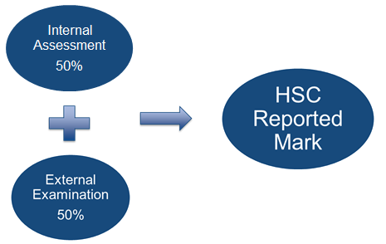
Year 10 Subject Selection for Stage 6
How is the HSC Mark Determined?

Slide 24
Australian Tertiary Admission Rank

Slide 25
Year 10 Subject Selection for Stage 6
Australian Tertiary Admission Rank
The Australian Tertiary Admission Rank (ATAR):
is for students wishing to gain a place at a university
is a rank NOT a mark
provides information about how a student performs overall in relation to other students
Notes:
UAC will only consider Board Developed Courses in the calculation of the ATAR.
The ATAR provides the discrimination required by universities for the selection process.

Slide 26
Year 10 Subject Selection for Stage 6
Other Considerations
What do I want for my future?
What ‘pathway’ best suits me?
Ask for advice from:
teachers
parents
Year adviser
careers adviser
Notes:
http://educationstandards.nsw.edu.au/wps/portal/nesa/11-12/hsc/subject-selection

